Slide 1
Cyber Crime Investigations
Investigation process
Prof. Shumba
January 16,2019
© Copyright 2014: Jenny A. Applequist. All Rights Reserved.

Slide 2
This week’s goal
What is involved with a forensics investigation from the beginning to when you hand off your results in the form of a forensic report to the party requesting your services?

Slide 3
Coverage
Casey Model of Investigation(2002)
Assess:
Pre-investigation checklist
Opening a forensic case and logging work.
Search and seizure
Role of the chain of custody
Acquire:
Analyze:
Report writing and reconstruction
Critiquing the case

Slide 4
What we covered yesterday!
Know the goal of the investigation
Know who the first responder was
Have a solid documentation of the environment to be investigated.
Validate that you can access all systems on the asset list (US laws, search warrants)

Slide 5
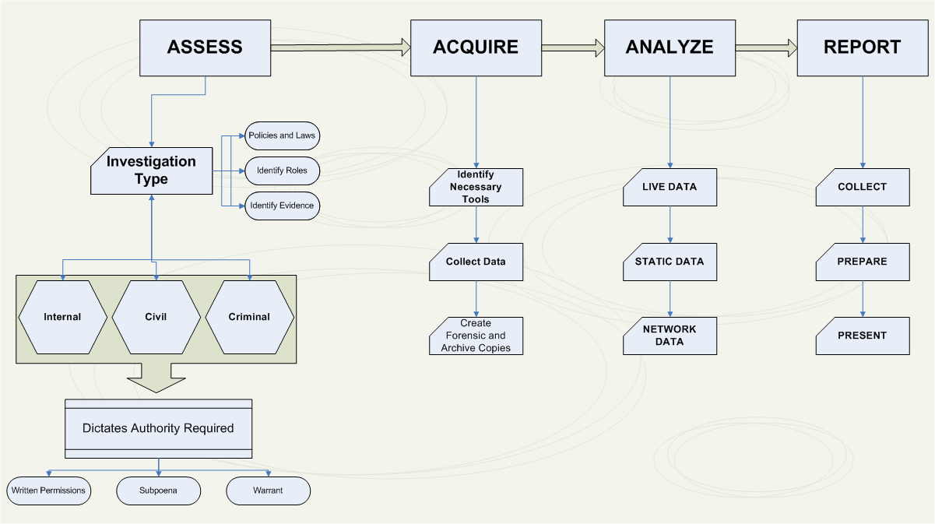

Slide 6
Finishing point
Role and responsibilities of the first responder.
Discussed the tools a first responder needs.

Slide 7
Today
Tools needed by the first responder
Securing the crime scene including the device power state.
Chain of custody
Forensic reports

Slide 8
What tools do you need as responder?
Powerful laptop (two recommended) with Windows and Linux (ensure that it is sanitized, meaning that is clean of malware, up to date with patches, and configured with proper security settings)
Large external hard drives for duplicating lots of data
USB memory sticks for quick copies
Hard drive write blockers
Digital camera
Kali Live CD and Live USB
Four-port hub, not a switch
Chain of custody, disclosure, and permission forms
Assorted tools and hex drivers
Portable label printer, notebook, voice recorder, pens
Crime tape

Slide 9
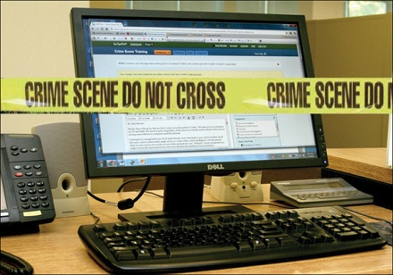
Crime Scene

Slide 10
Securing the area?
You need to monitor the crime scene? Why?

Slide 11
Securing the place
Any gaps in monitoring - contamination to your investigation, which means an opportunity for an outside party to impact the evidence.
Need a log of the parties responsible for monitoring the contained crime scene (contact information)
Need someone with legal authority, such as a security guard or police officer versus a general employee of the company.

Slide 12
Securing the scene
It is illegal for you to access a system without a warrant or the system owner’s permission except what is publically viewable:
that is includes what can be seen on the monitor, if the officer/investigator has a legal right to be there and the discovery was done by chance.
.

Slide 13
Device power state
How are the devices powered or connected to a network?
Powered from a wall jack using technology such as power over Ethernet (PoV)
Cellular communications
Bluetooth or Wireless network card.
Do not change the state of the system unless doing so is unavoidable? Why?

Slide 14
Power State
Powered systems are likely to have volatile data.
Data in RAM – important?
many forms of malware do not install themselves on the hard drive.
network tables in a router
Problems with powering down the system?
Destroy this data, and the power cycle can modify the asset.
Who is liable when a device is powered off?
Always collect data based on order of volatility.

Slide 15
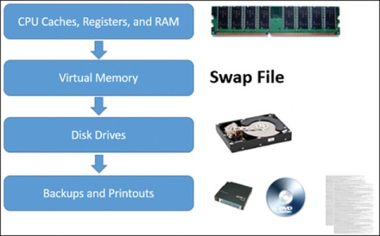
Order of volatility

Slide 16
Order of volatility
Internet Engineering Task Force (IETF) document RFC3227
https://tools.ietf.org/html/rfc3227#section-2.1
For each of the devices you need to collect and preserve evidence (next topic for next week).

Slide 17
Preparing for Computer Investigations
Digital forensics falls into two distinct categories
Public investigations
Private or corporate investigations
Public investigations
Involve government agencies responsible for criminal investigations and prosecution
Organizations must observe legal guidelines
Law of search and seizure
Protects rights of all people, including suspects

Slide 18
Chain of custody
The process or life cycle of obtaining an artifact for an investigation.
Who has access to it, where it is stored, and its current state throughout the investigation process.

Slide 19
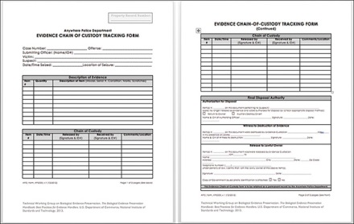
NIST –Chain of custody form

Slide 20
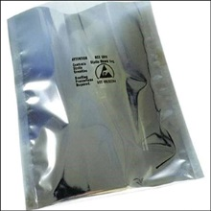
Hazmat bag

Slide 21
Forensic reports
The most visible part of the investigation.
Your report may make or break your career as an investigator.
Your report may make or break your career as an investigator.
Summarize everything that was performed and deliver that information in a clear and unbiased format.
People will not go to some link you reference to learn more about a topic.

Slide 22
Forensic reports
Spell out every acronym or include an appendix that explains what they are.
Provide background information on technical terms being covered
The attack was delivered through an exploit kit
Best practice – take notes during investigation process
Attach the logging tools report to the forensic report.

Slide 23
Closing the case
Handing off your findings – can be called back.
How to close:
Case tracking systems (Timelive) –logging
Either need to return the artifacts before closing the case before the warrant expires, or specify those artifacts are stored in a secure manner and document the last party involved with accessing those artifacts.
Sensitive data –shred or use Eraser
Drilling into the platter

Slide 24
Critique what was done
Spend time to critique what was done to improve your abilities.
Can use the IEEE digital forensics maturity documentation to critique the work.
SY486 class folder

Slide 25
Questions to ask
How could you improve your performance in the case you were involved in?
Did you receive the results that you expected to be found?
How was the quality of the forensics report that was delivered?
Were any new problems discovered during the investigation process?
What techniques or steps during the forensic process did you have concerns about?
What techniques or steps during the forensic process did you feel were very effective?

Slide 26
Warrant or Subpoena
A warrant authorizes law enforcement to perform a search and seize evidence
A subpoena orders an individual to appear in a certain place at a particular time with a collection of defined articles of evidence.
A subpoena orders an organization to surrender or allow to be examined tangle evidence as defined by the order.

Slide 27
Summary
Explained the questions and practices you need to perform before an investigation.
Covered how to properly open a case and how important it is to leverage forensic case management technology.

